Slide 1
物聯網實務 HW12
電機碩一 11278008 林佳慧
日期:2023/12/06

Slide 2
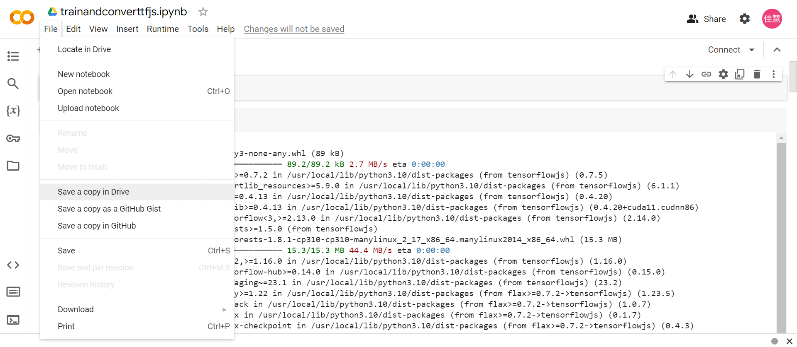
Code in Colab

Slide 3
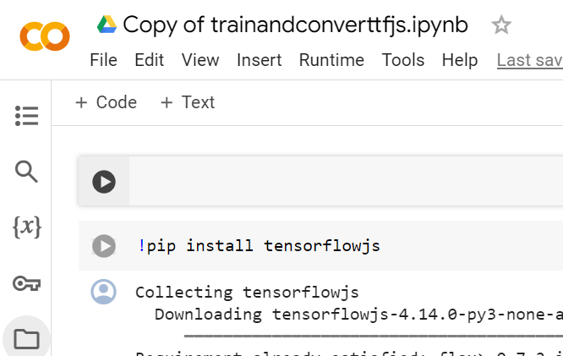
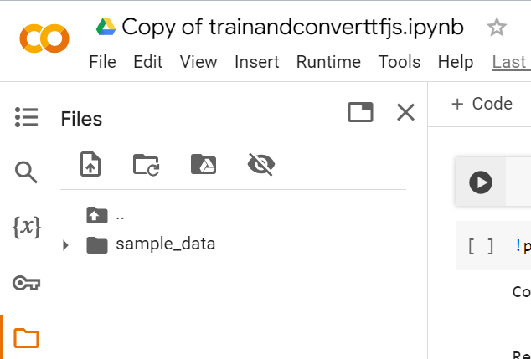
Copy of trainandconverttfjs.ipynb

Slide 4
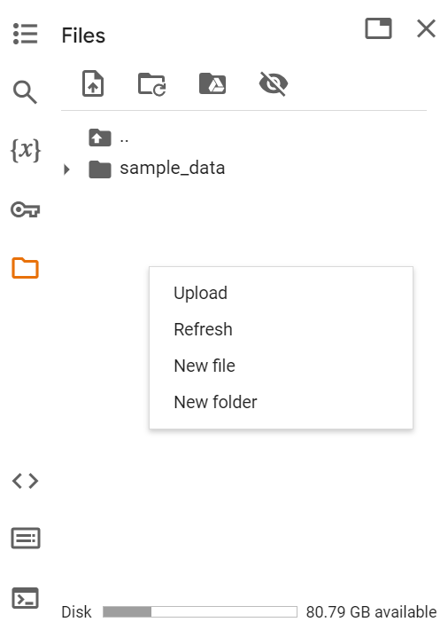
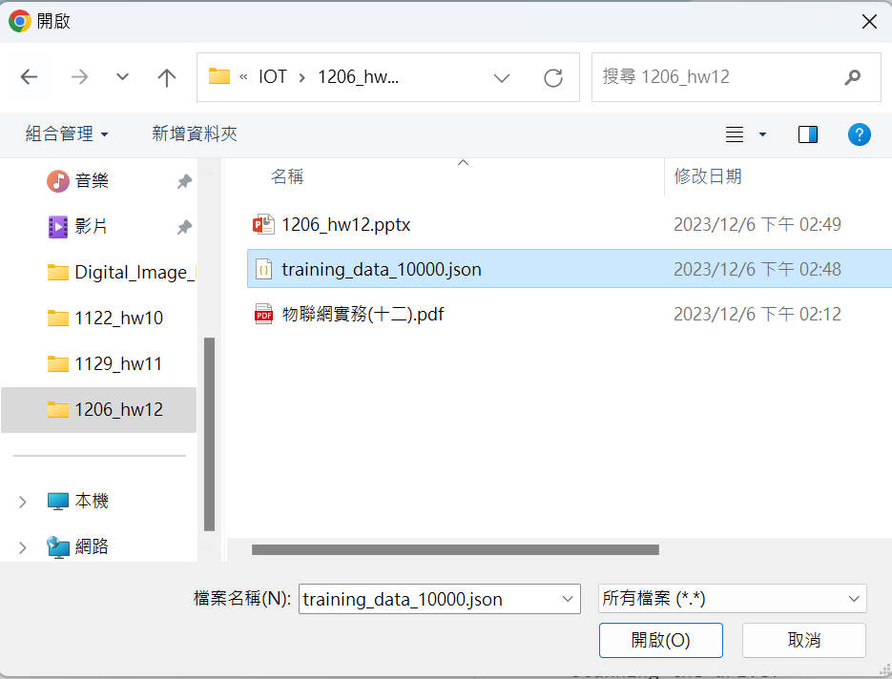
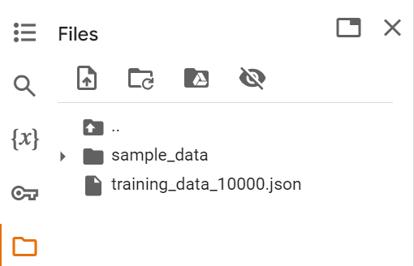
Upload
training_data_10000.json
Colab

Slide 5
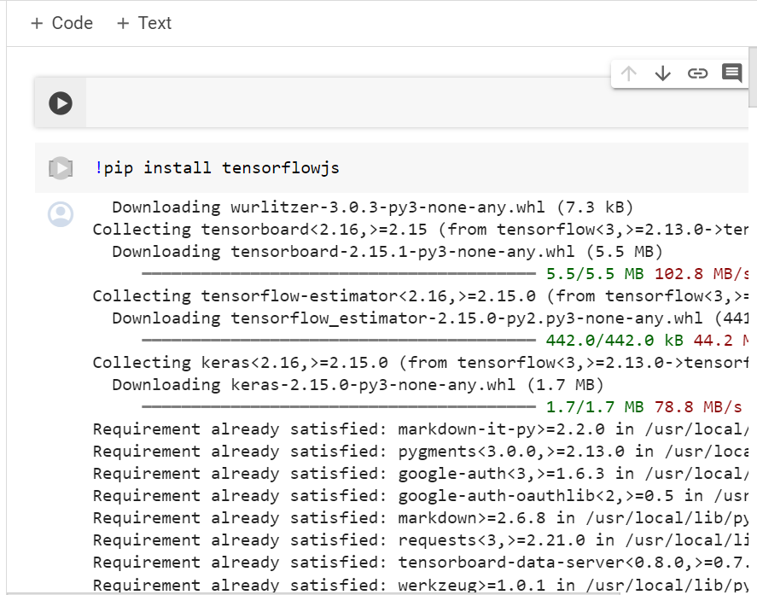
!pip install tensorflowjs

Slide 7
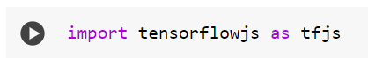
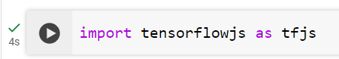
import tensorflowjs as tfjs

Slide 8
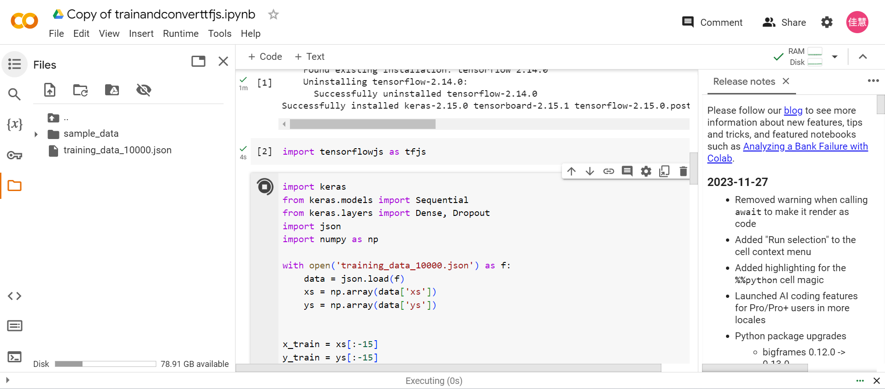
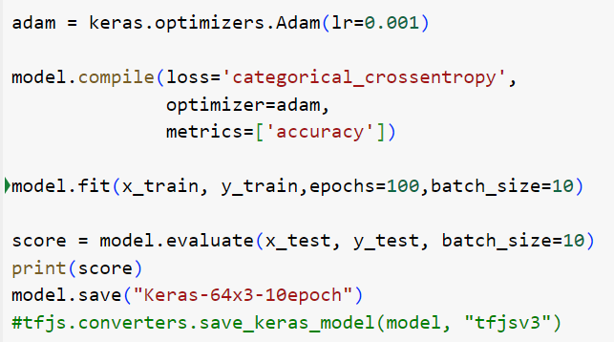
train

Slide 9
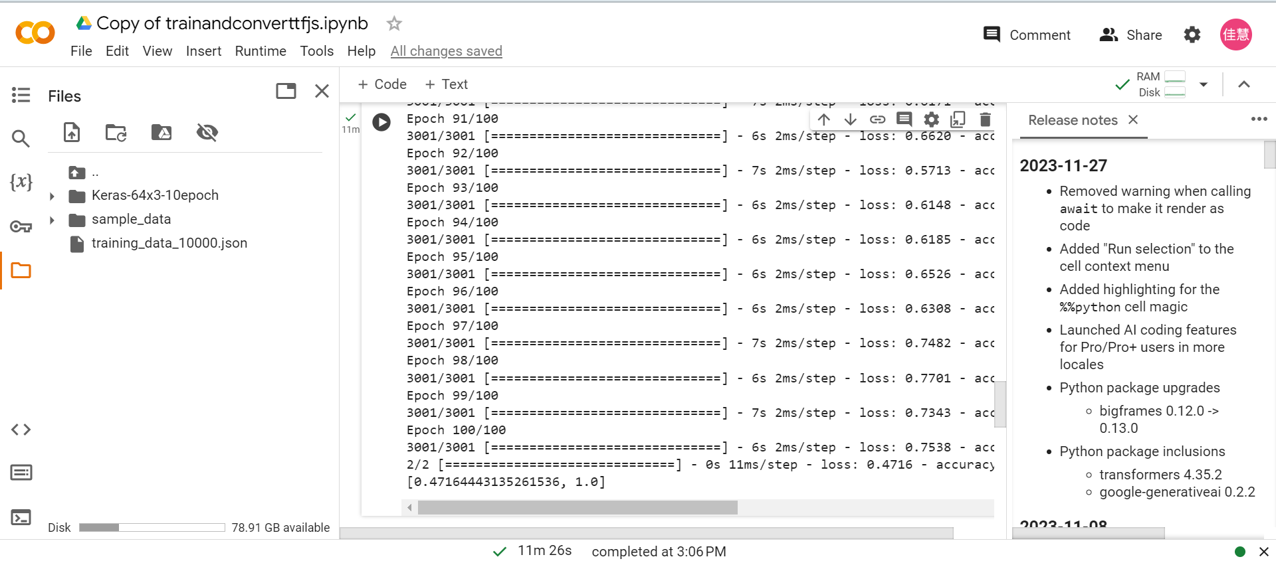
generate Keras-64x310epoch

Slide 10
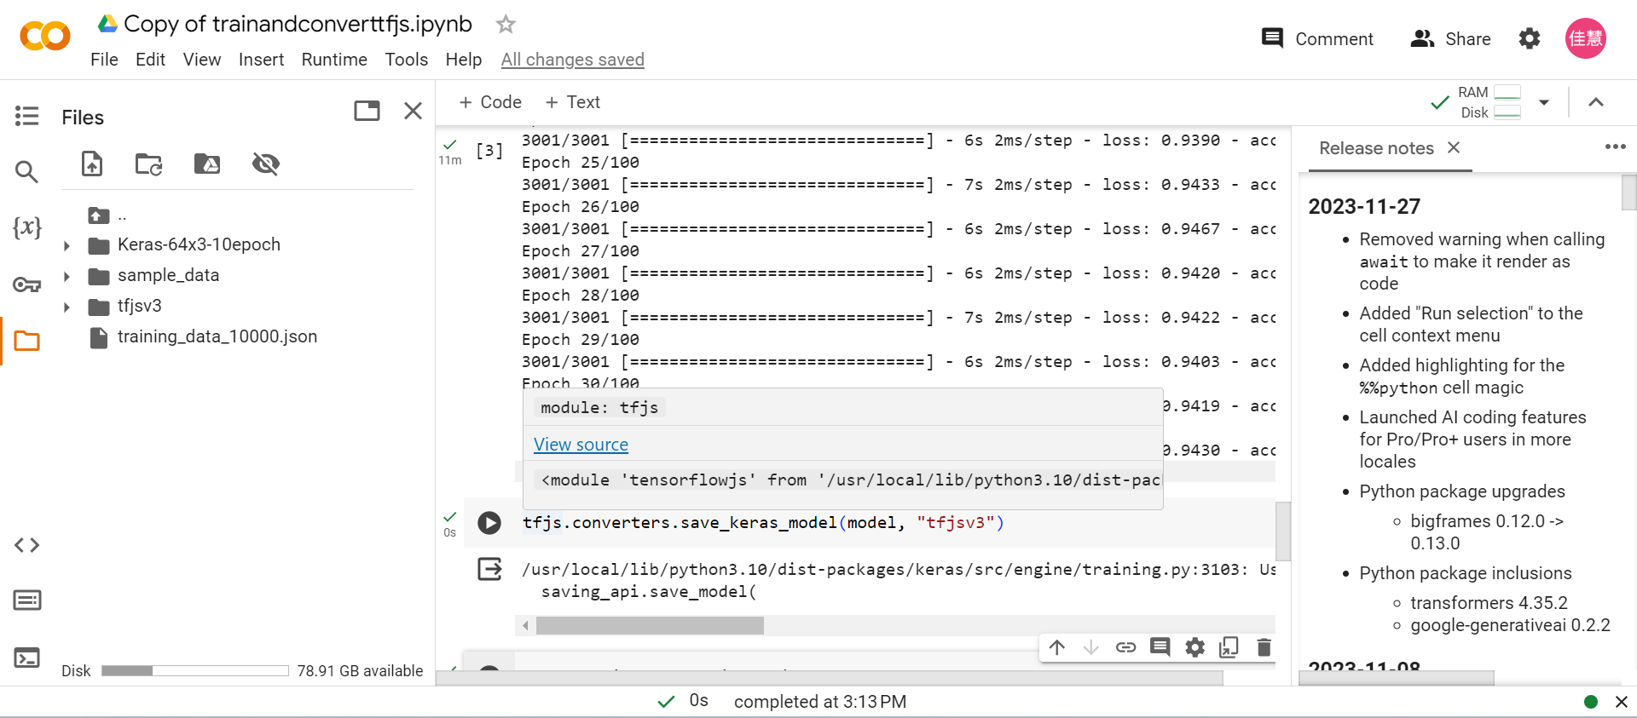
tfjs.converters.save_keras_model(model, "tfjsv3")

Slide 11
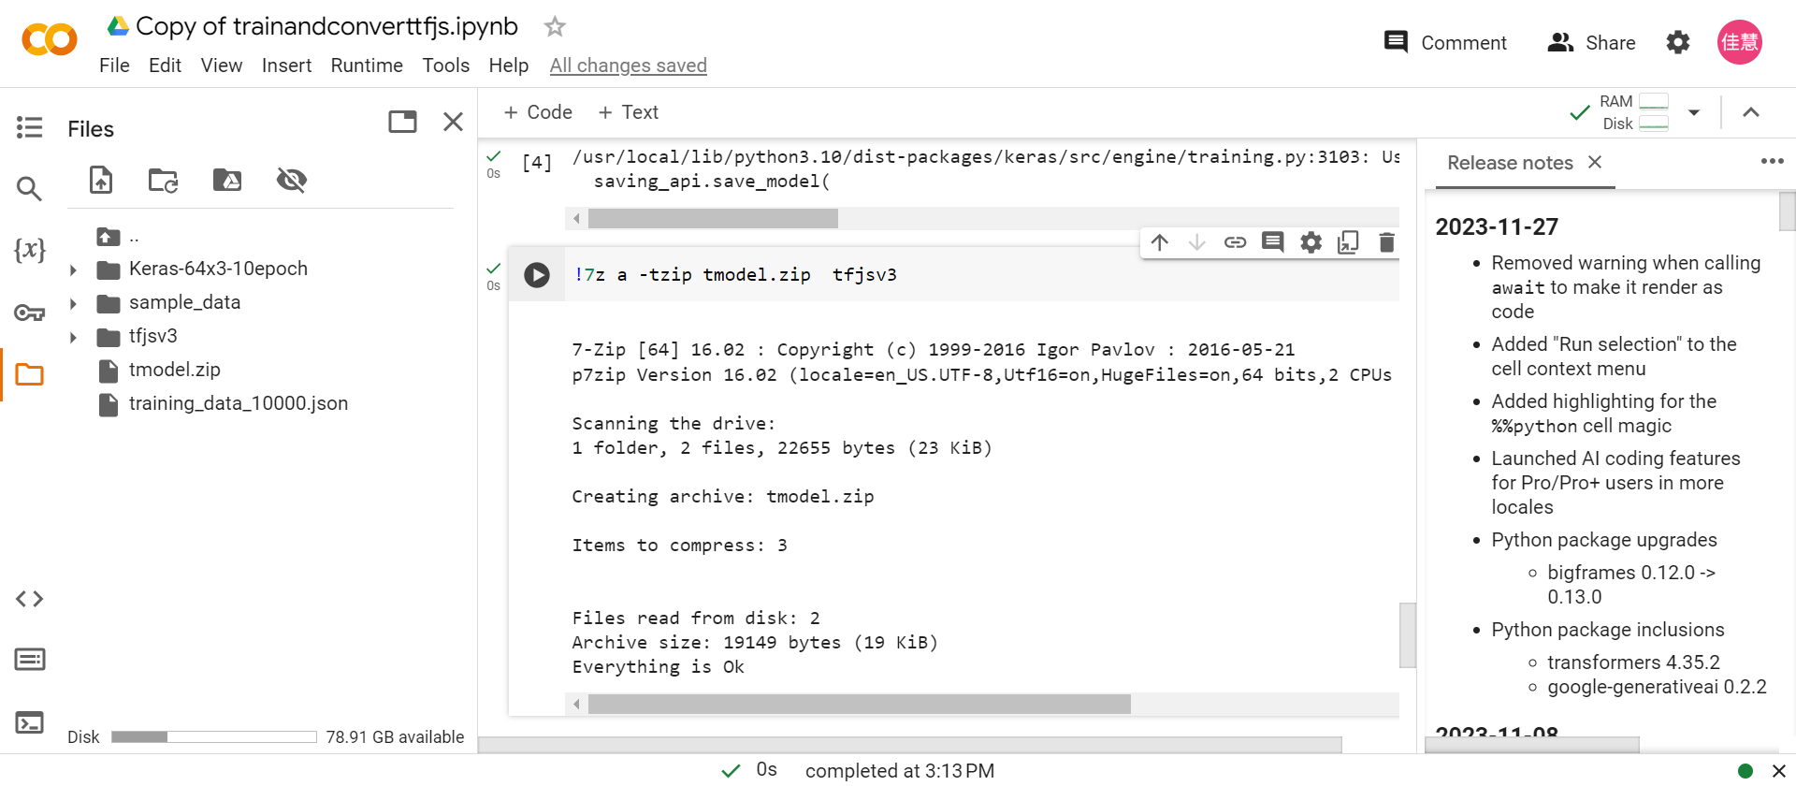
!7z a -tzip tmodel.zip tfjsv3

Slide 12
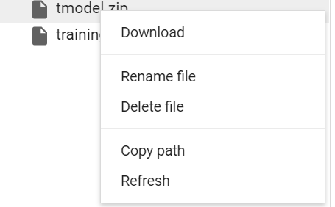
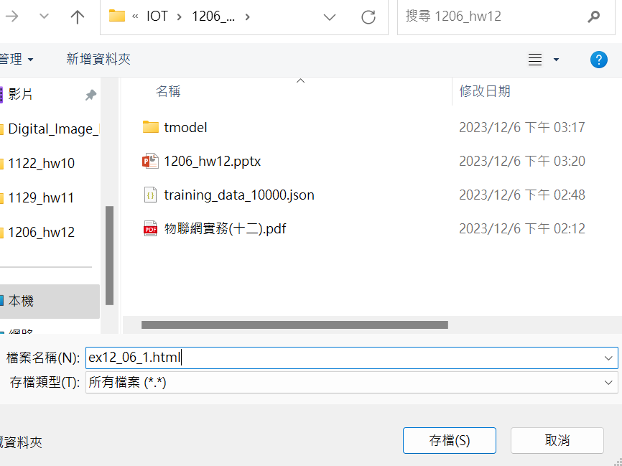
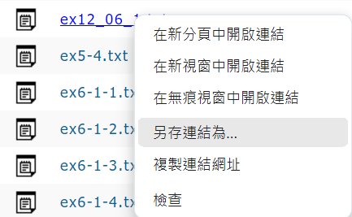
Download
Save as html file
Download ex12_06_1.html

Slide 13
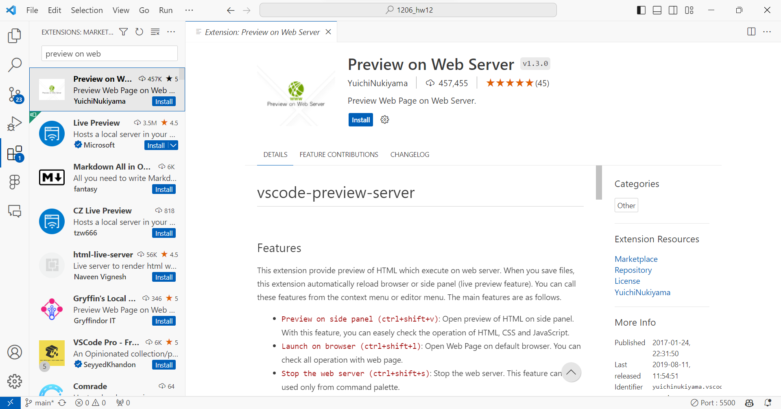

Slide 14
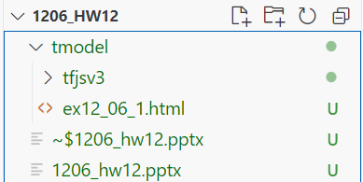
須將這兩個檔案放在同一個資料夾

Slide 15
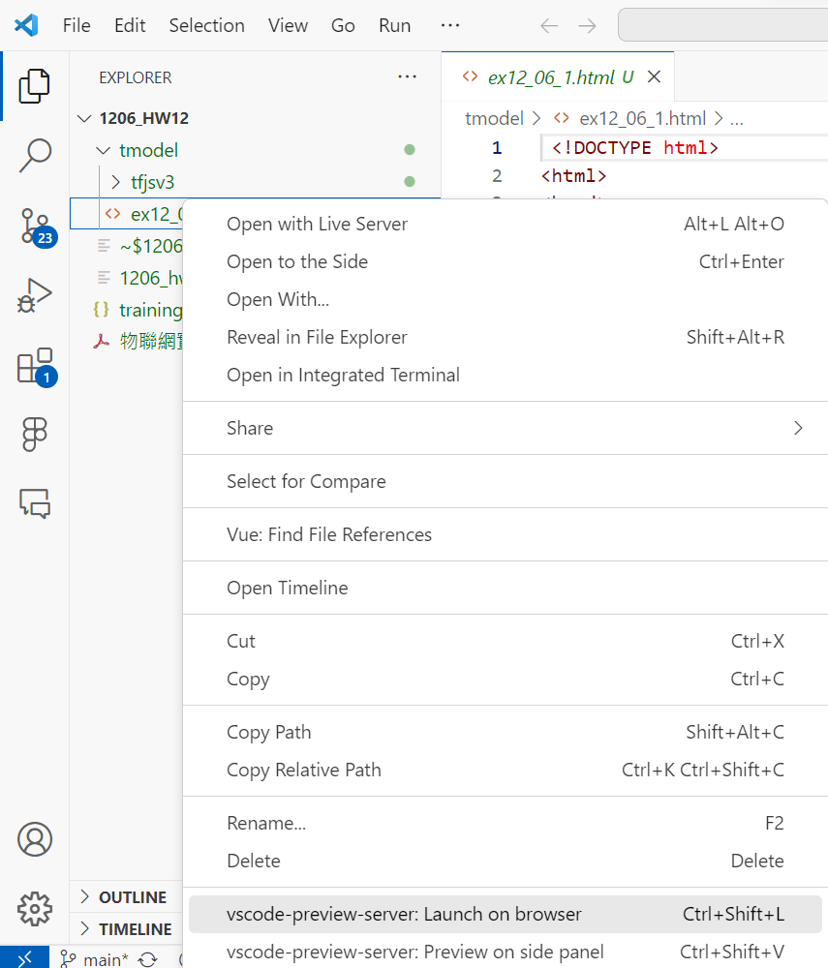
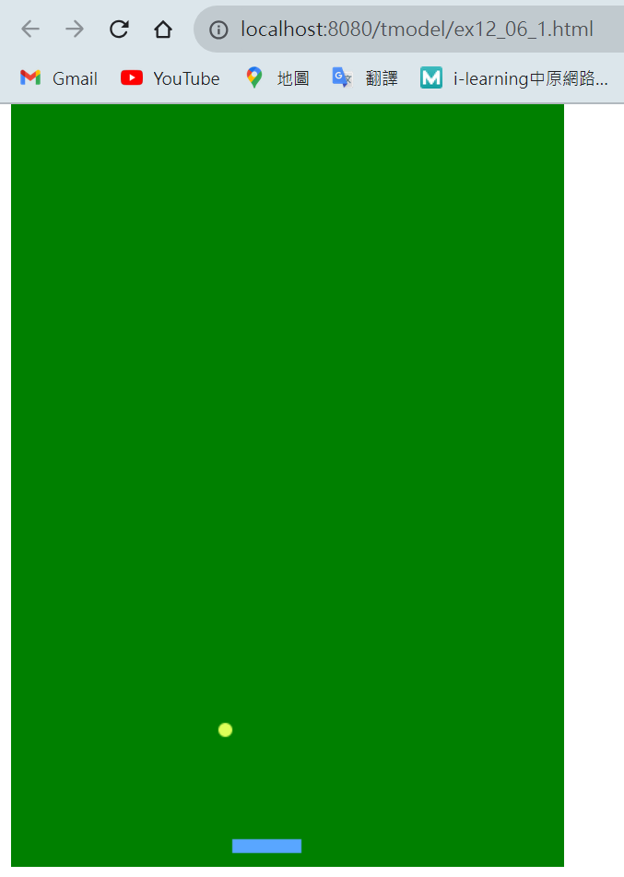
Right click
localhost:8080/ex12_06_1.html

Slide 16
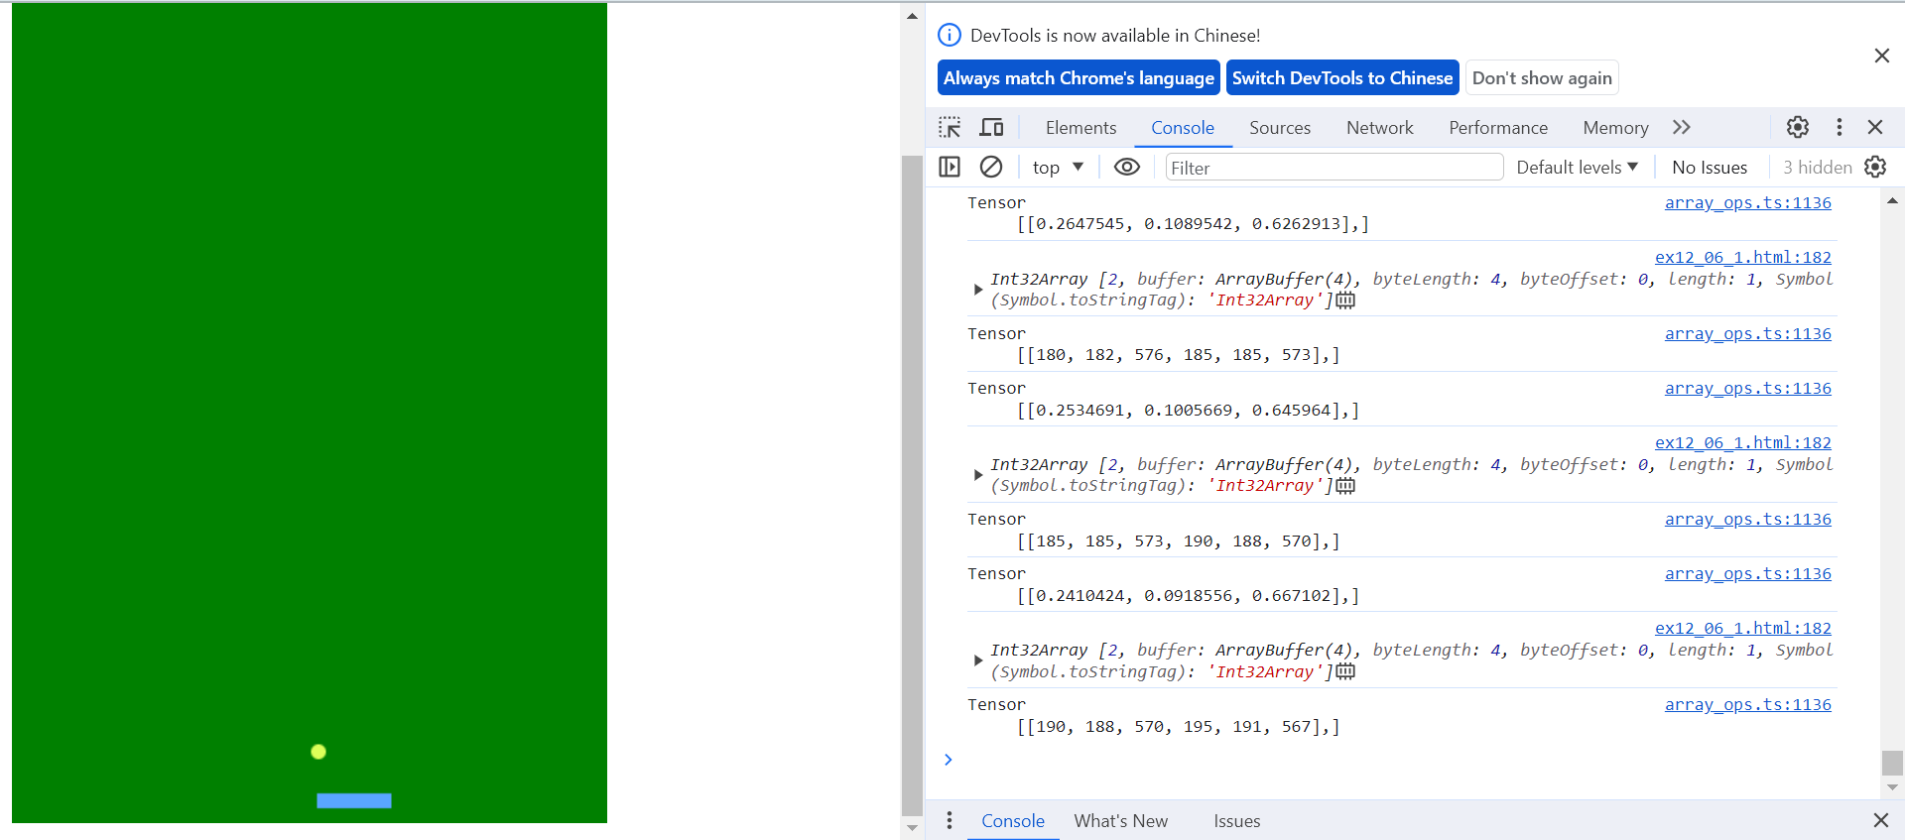
Ctrl+shift+I/ F12

Slide 17
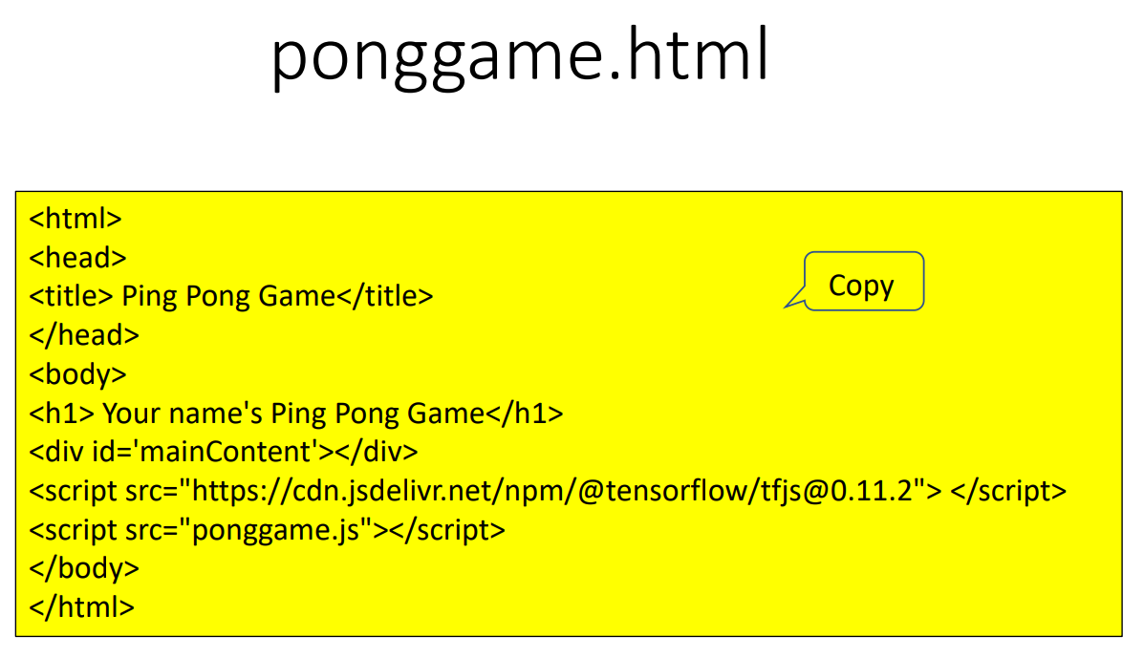

Slide 18
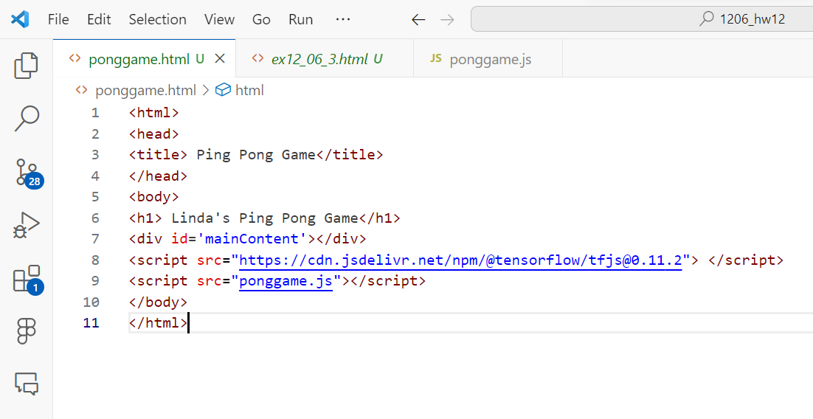
Paste & Save

Slide 19
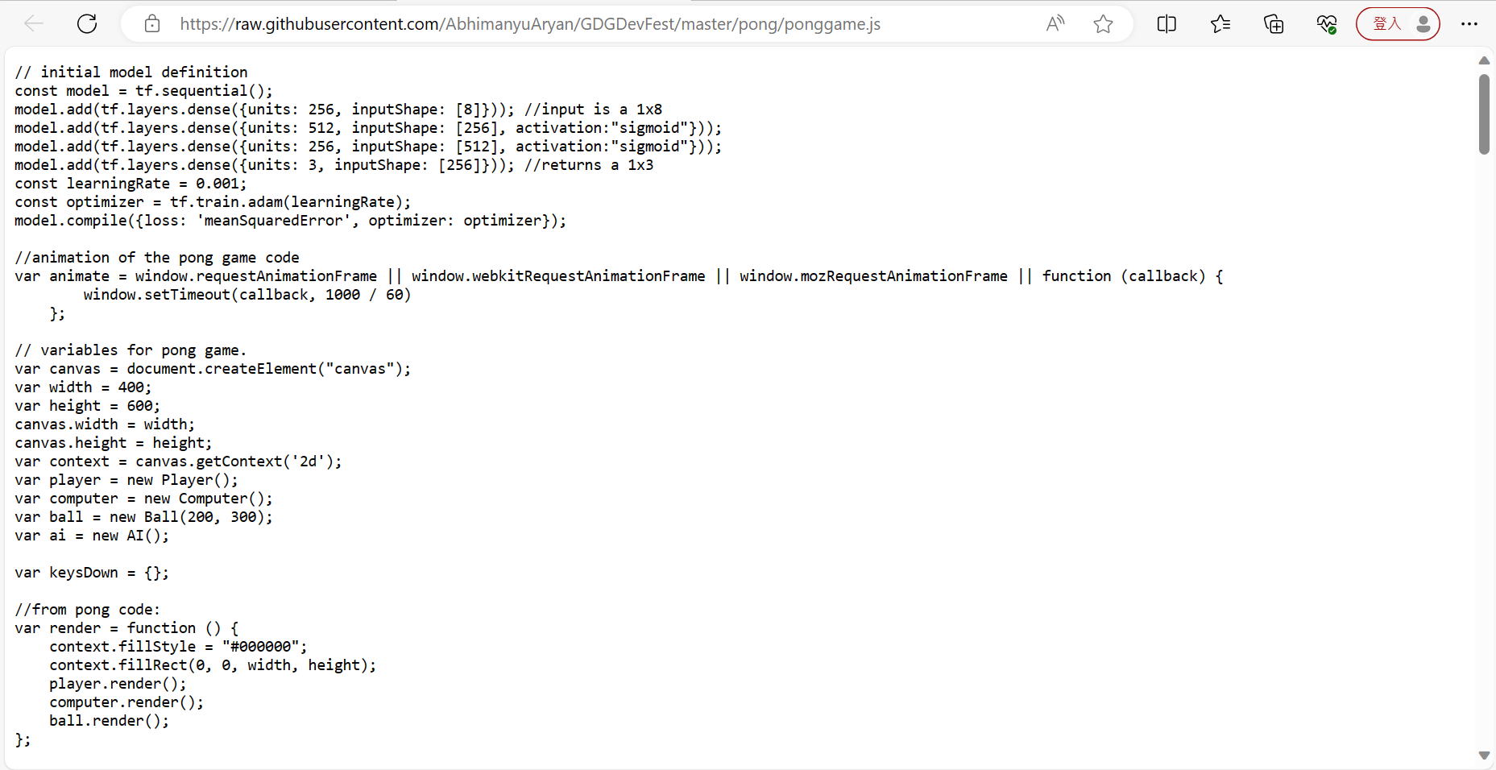
raw.githubusercontent.com/AbhimanyuAryan/GDGDevFest/master/pong/ponggame.js
Copy all

Slide 20
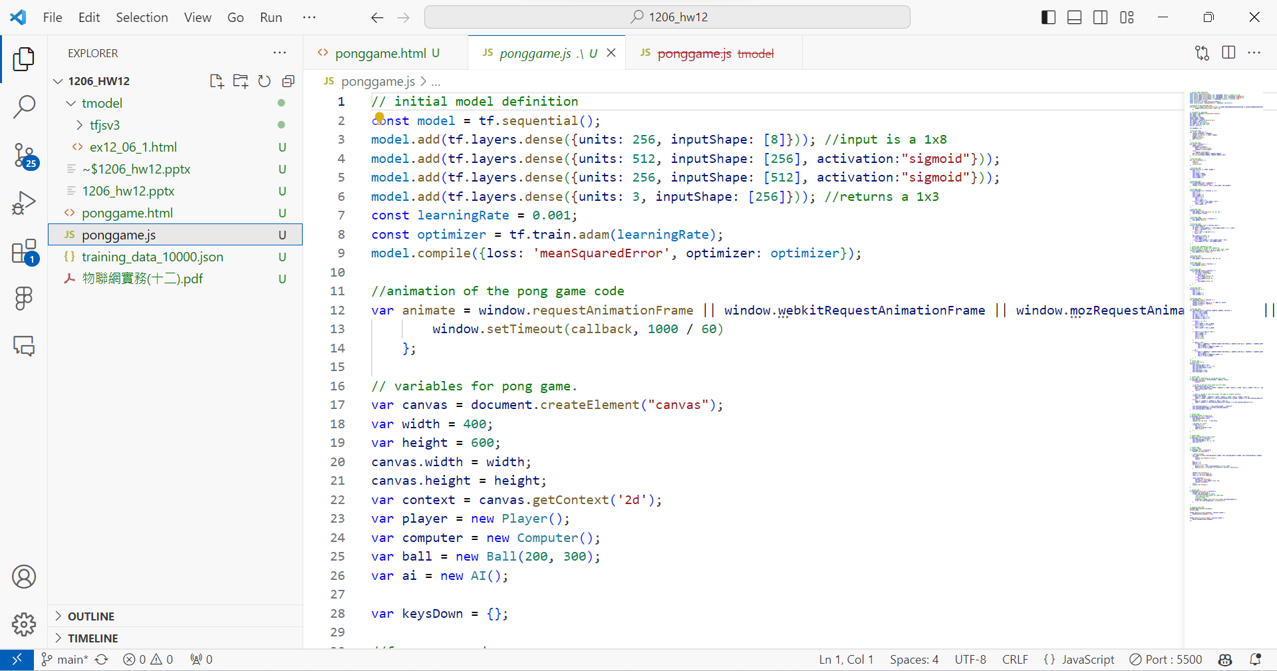
Save as ponggame.js
Paste

Slide 21
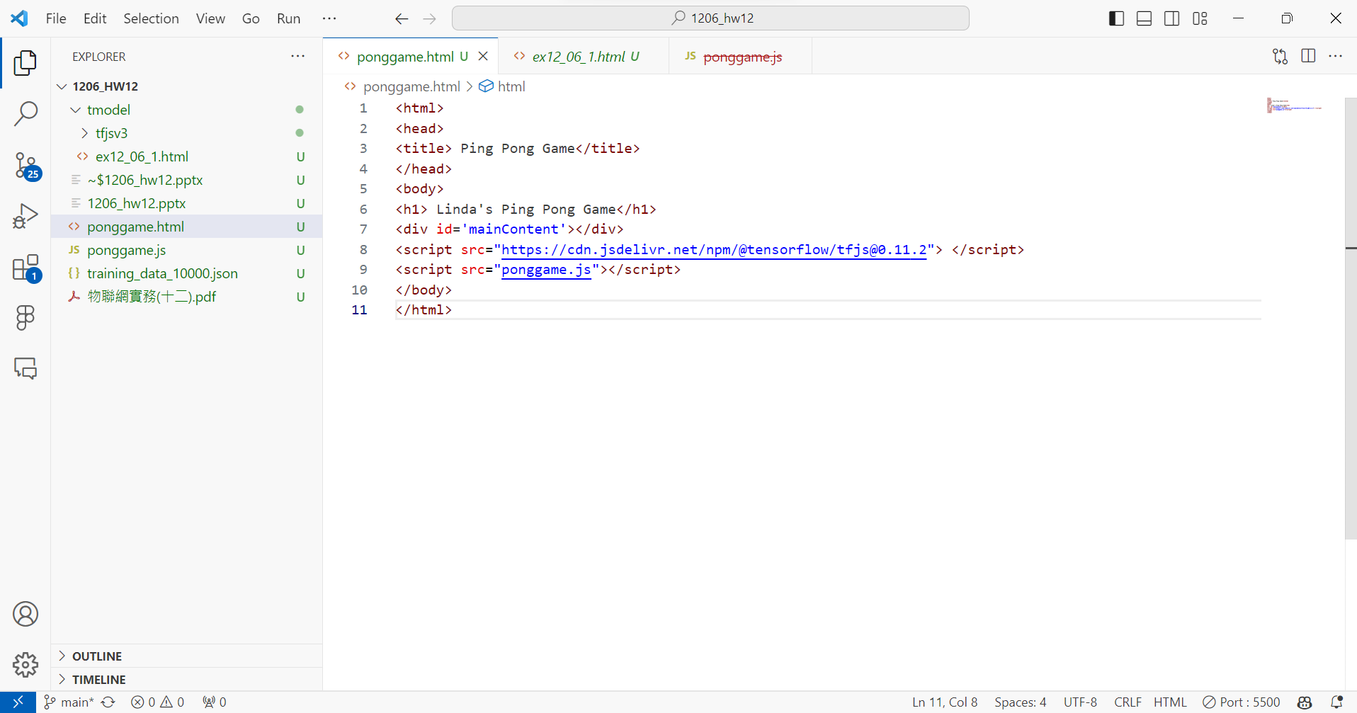

Slide 22
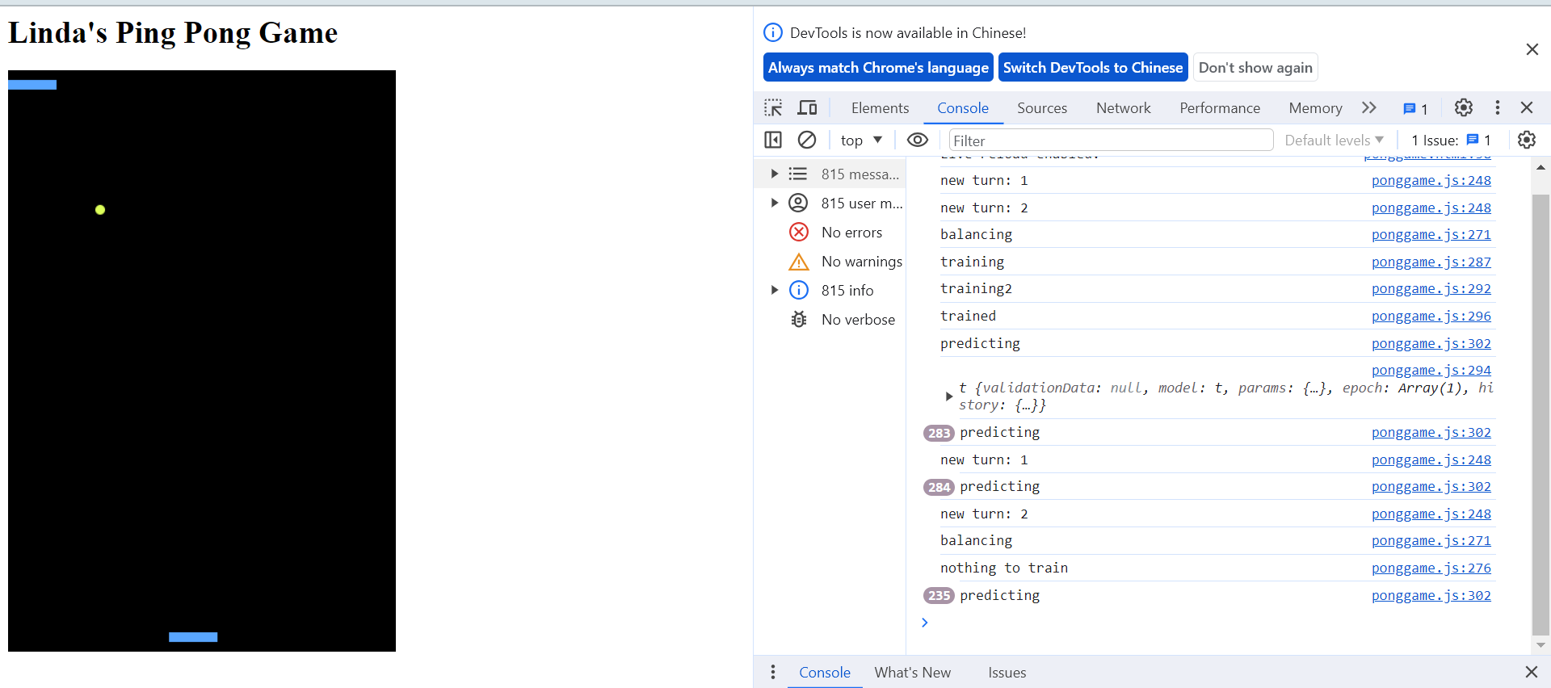
ponggame.html

Slide 23
Exercise 12-1
training a model in Python

Slide 29
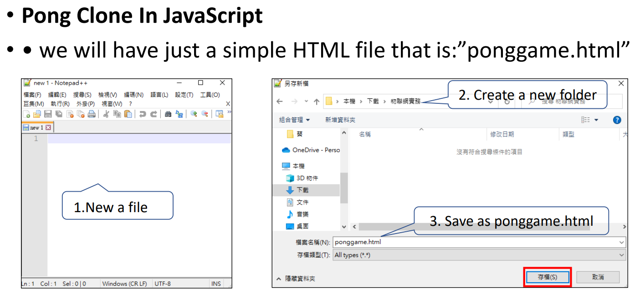
Exercise 12-2

Slide 34
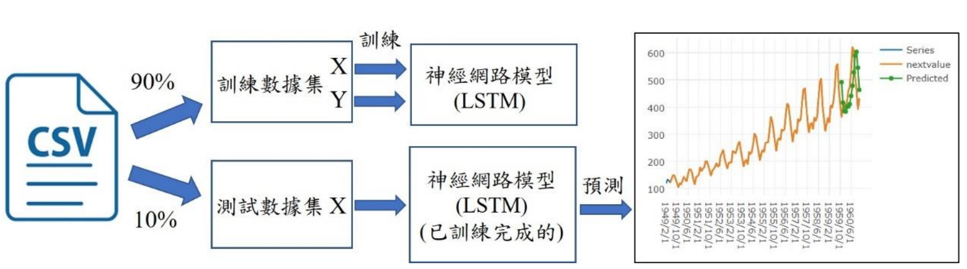
Exercise 12-3
使用csv檔案與LSTM網路進行時間序列預測的實驗架構圖

Slide 35
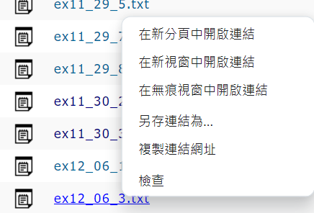
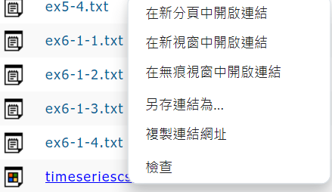
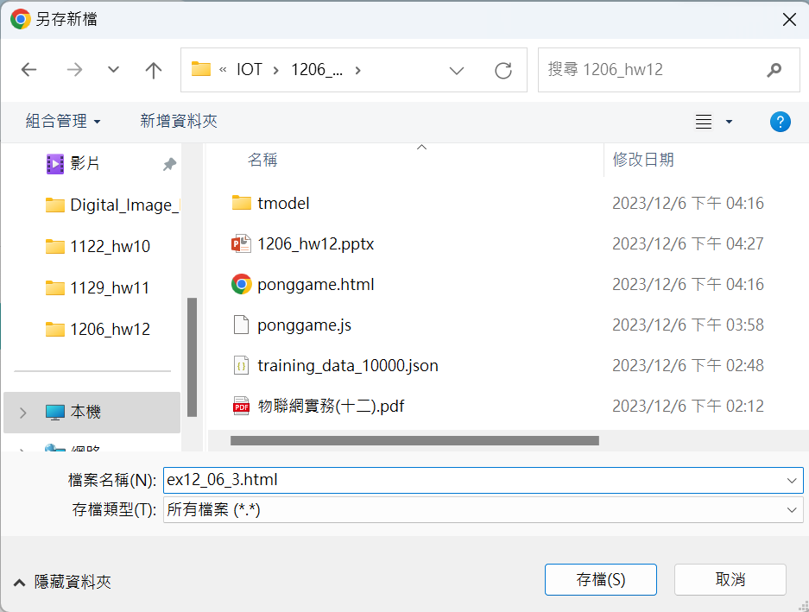
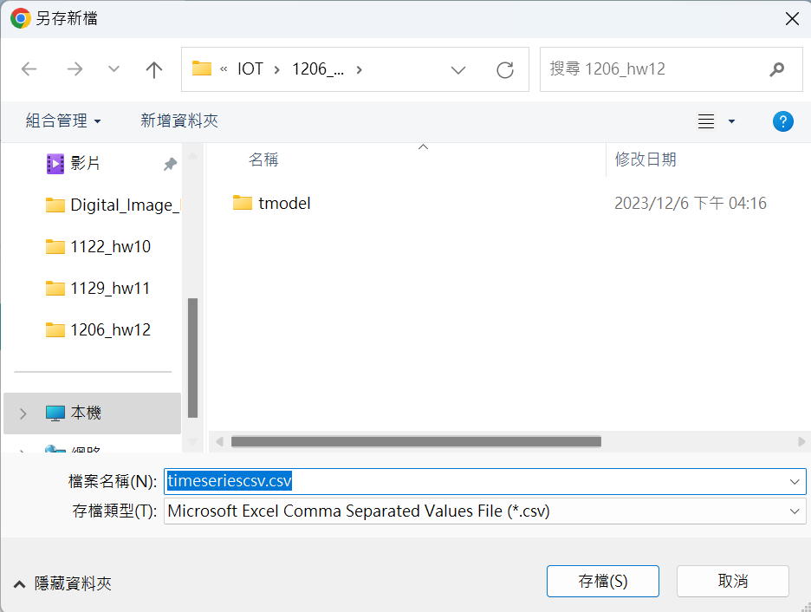
Download ex12_06_3.txt
Download timeseriescsv.csv
Right click
Right click
Save as ex12_06_3.html
Save

Slide 36
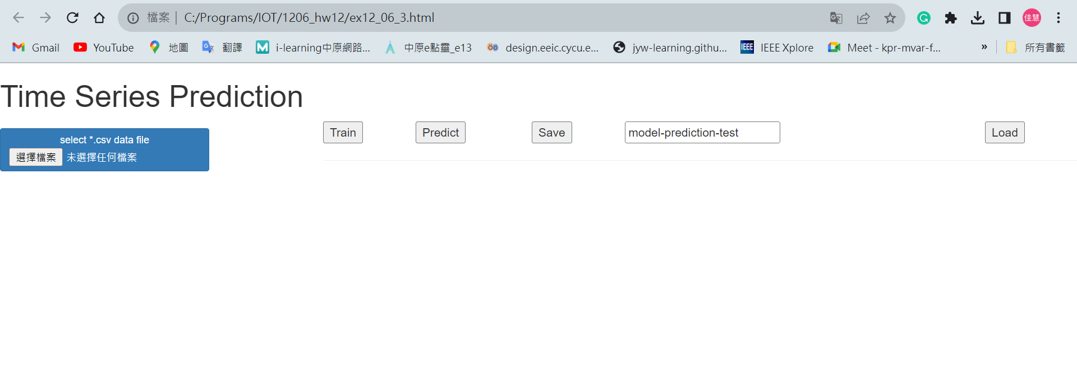
2. Train
3. Predict
1. 選出”timeseriescsv.csv”

Slide 37
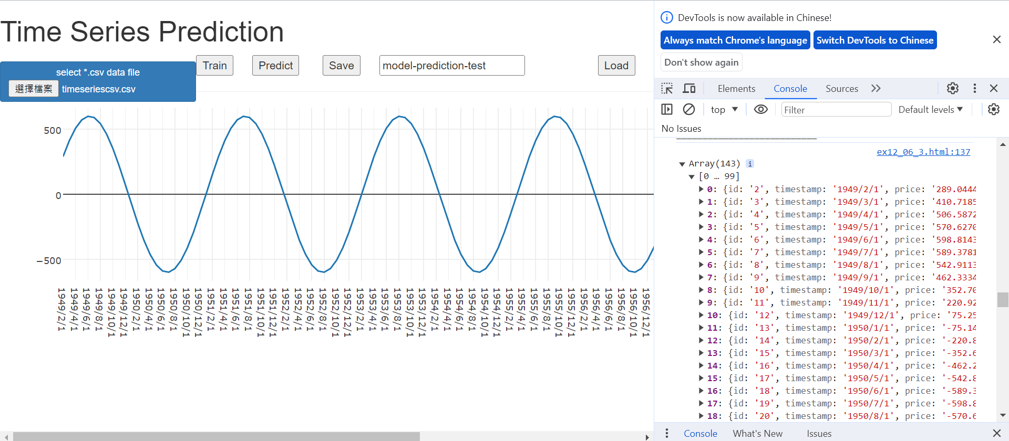
1. Ctrl+shift+I / F12

Slide 38
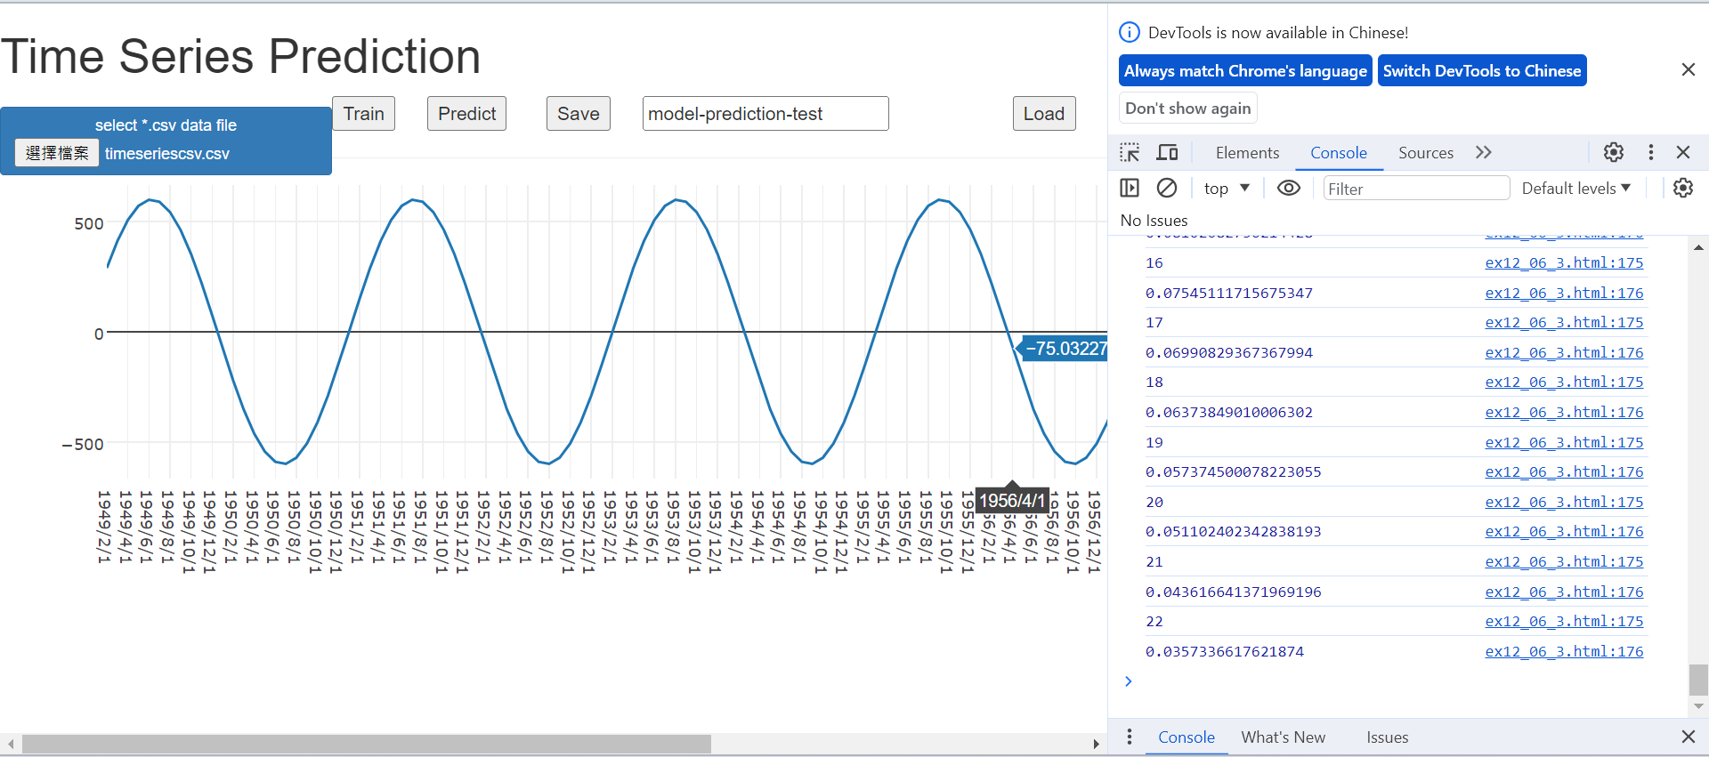
Train

Slide 39
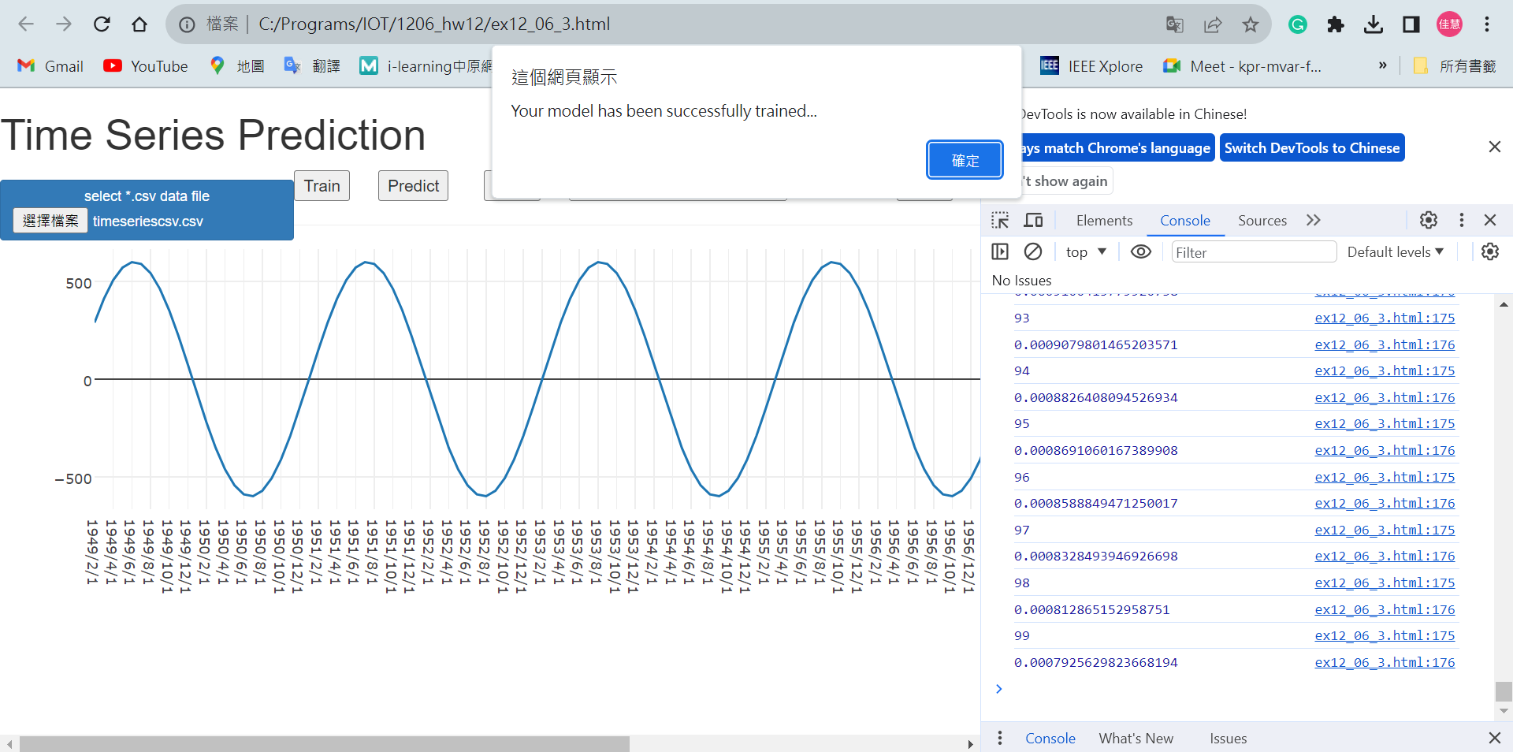
Trainning finished

Slide 40
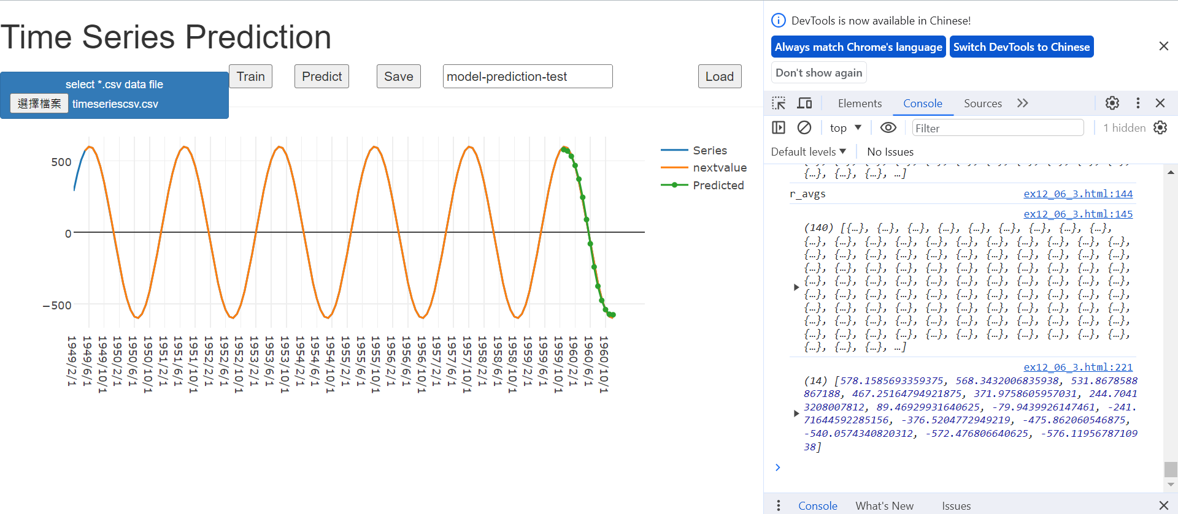
Predict
Green line: Predicted

Slide 41
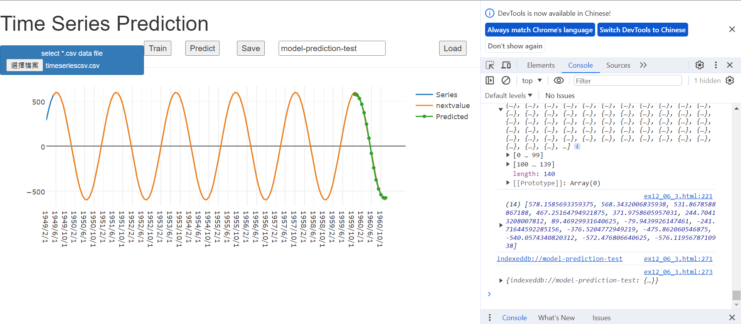
Save
Save address

Slide 46
Exercise 11-8
Training Model
ex11_29_8.html
(copy from ex11_29_8.txt)

Slide 47
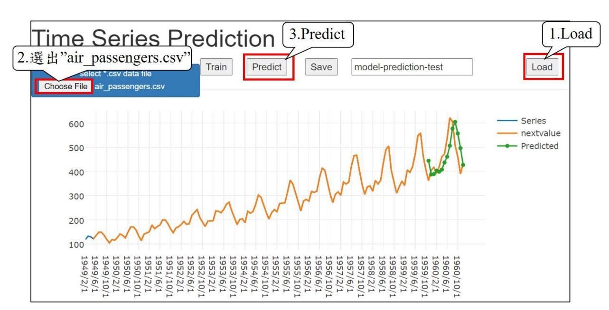
Homework 12-1

Slide 48
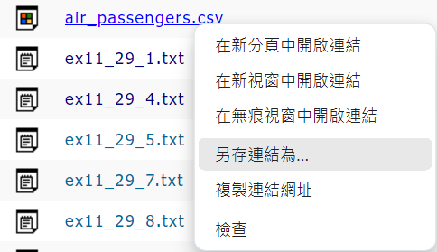
Download air_passengers.csv and save as

Slide 49
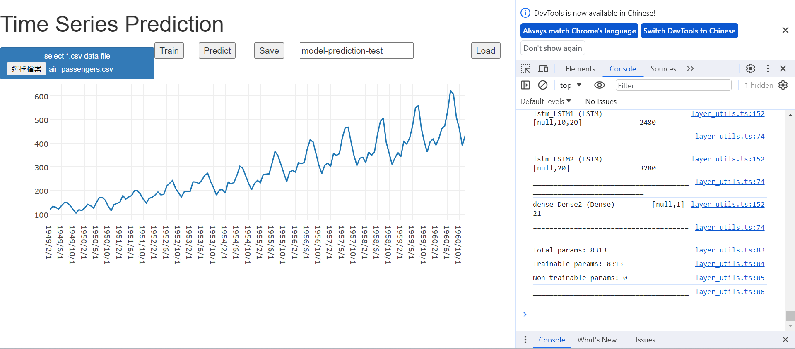
2. Train
3. Predict
1. 選出”air_passengers.csv”
Save as ponggame.js

Slide 50
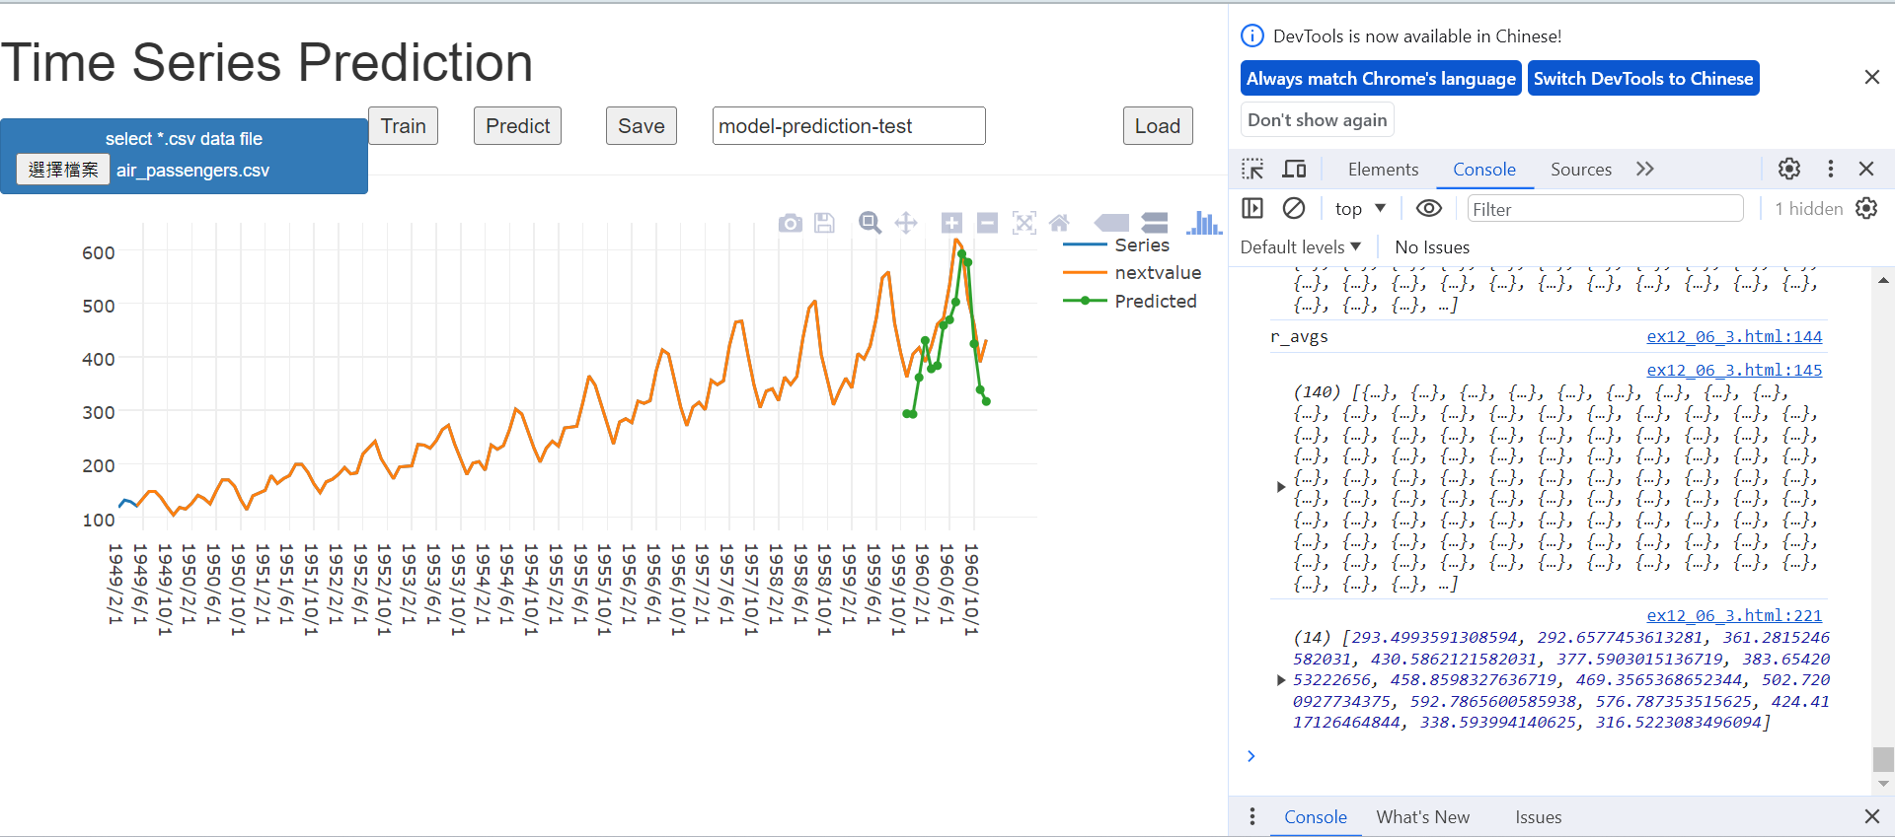
Load
載入ex12_3訓練好的模型的預測曲線

Slide 51
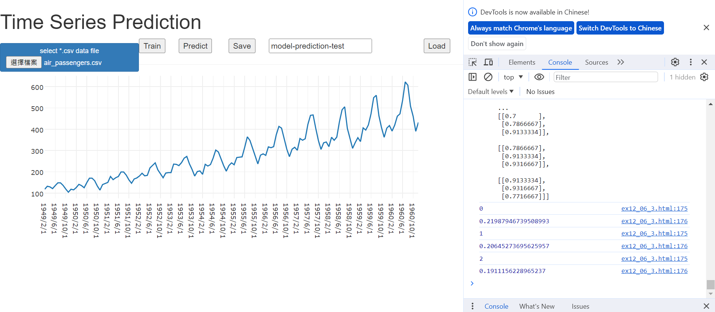
Train
訓練進度

Slide 52
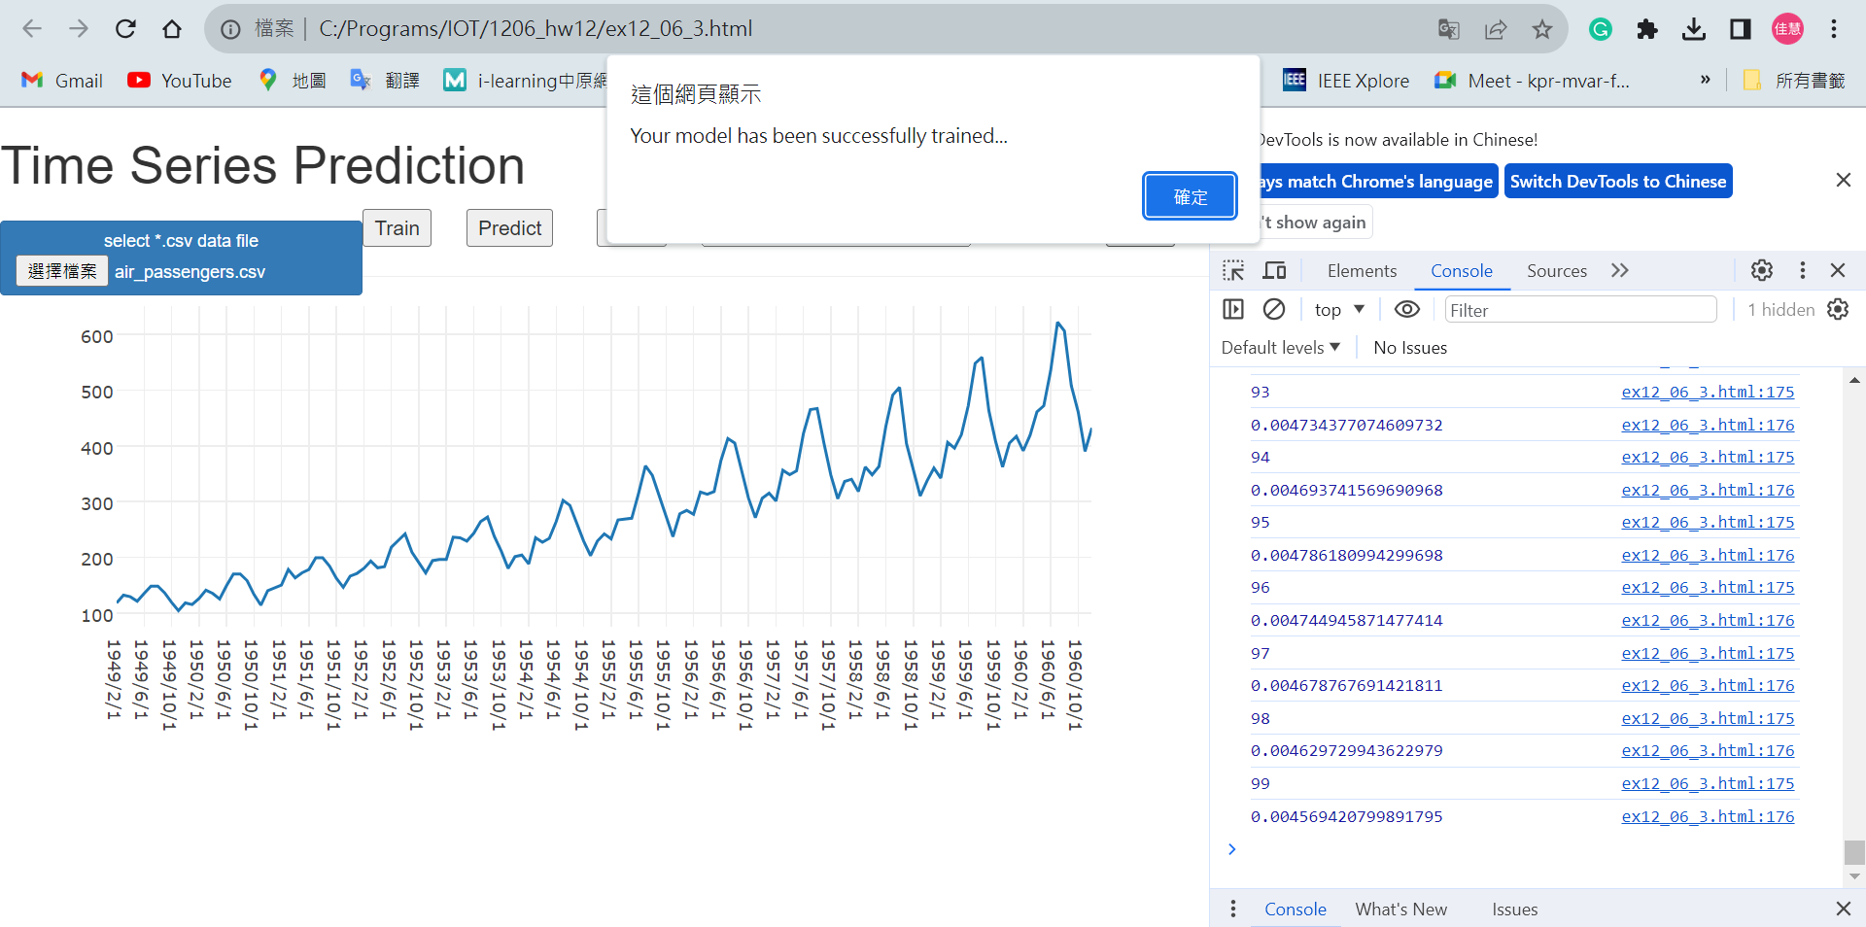
Trainning finished

Slide 53
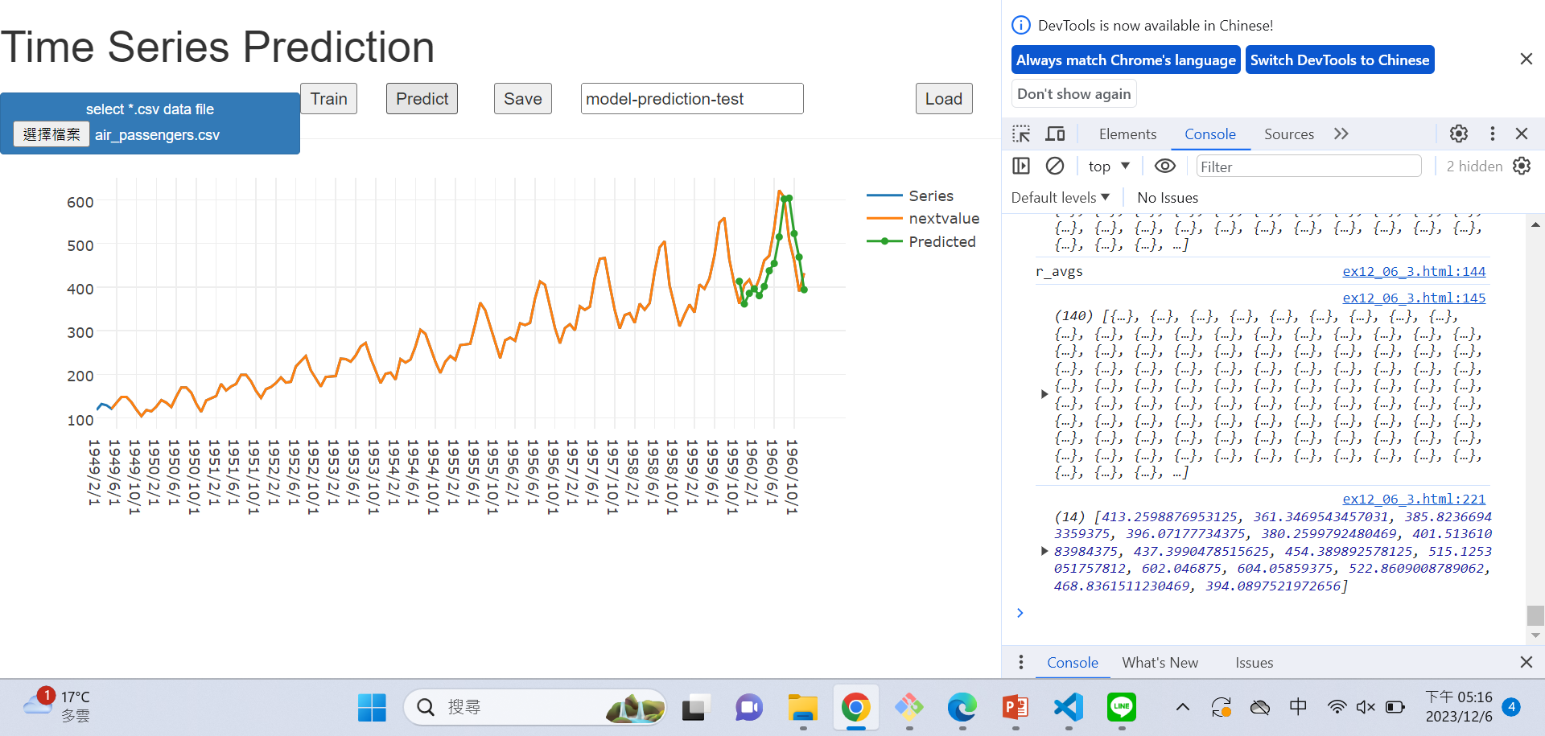
Predict

